Slide 1
Colorectal Cancer

Slide 2
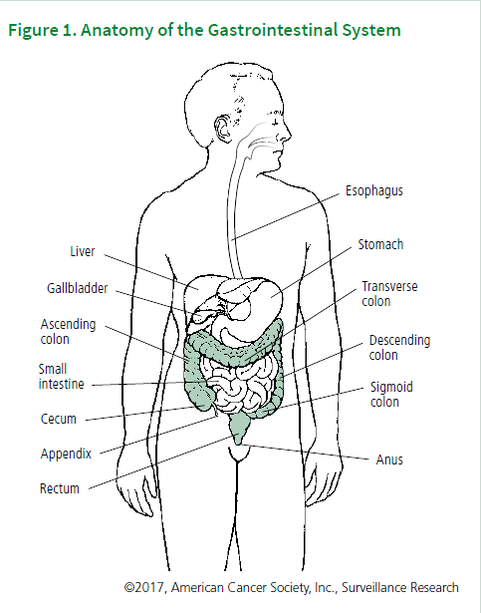
What is colorectal cancer?
Cancer is a disease characterized by the unchecked division of abnormal cells. When this type of growth occurs in the colon or rectum, it is called colorectal cancer (CRC).
The colon and rectum (colo-rectum), along with the anus, make up the large intestine.
Tumors within the colo-rectum vary in their molecular, biological, and clinical features, and in their association with risk factors.

Slide 3
What is a colorectal polyp?
CRC almost always begins as a polyp, which is a noncancerous growth that develops in the mucosal layer of the colon or rectum.
Polyps are common, detected in about half of average-risk individuals 50 years of age or older undergoing colonoscopy, with higher prevalence in older age groups and among men compared to women. However, fewer than 10% of polyps are estimated to progress to invasive cancer.
Polyps are classified based on their growth pattern as Adenomatous, or Serrated.
Serrated polyps are further subdivided into sessile serrated polyps (SSPs), traditional serrated adenomas (TSAs), and hyperplastic polyps (HPs).
SSPs are the most difficult to detect during colonoscopy because they are usually flat, covered with a mucous cap, and colored like the surrounding tissue.

Slide 4
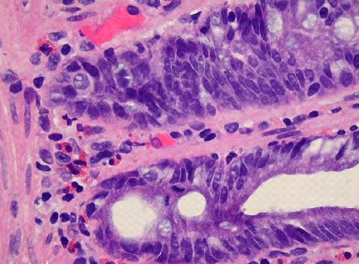
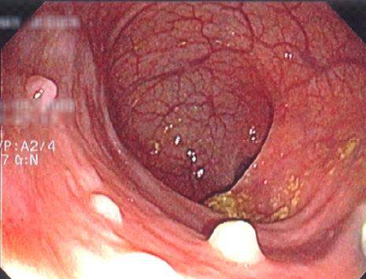
Hyperplastic Polyps
www.GI-Pathology.net
www.GI-Pathology.net
The epithelial cells at the base of the crypt (regenerative zone) have mildly enlarged, but uniform nuclei and brisk mitotic rate, feature which is normally present in reactive colonic mucosa
Endoscopic image of hyperplastic polyps

Slide 5
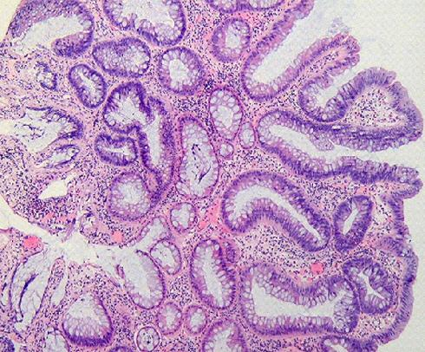
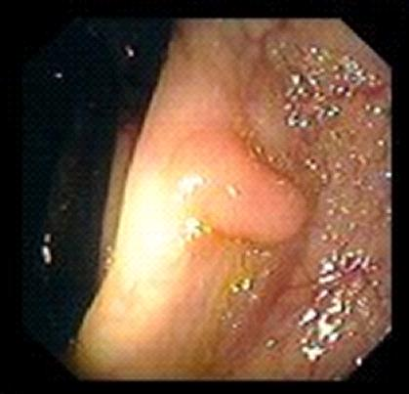
Tubular Adenoma
www.GI-Pathology.net
www.endoatlas.com/atlas_co.html
The adenomatous polyp has a smooth outline and is composed of numerous architecturally simple crypts with mild irregularity in size and shape
Endoscopic image of a tubular adenoma

Slide 6
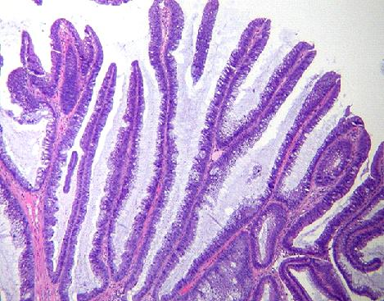
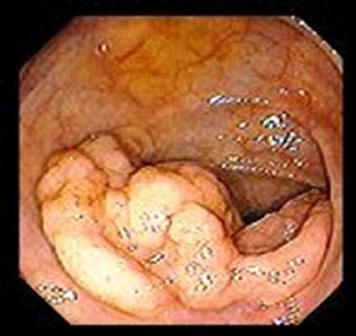
Villous Adenoma
www.GI-Pathology.net
www.endoatlas.com/atlas_co.html
Villous adenoma with glands that extend straight down from the surface to the base as fingerlike projections
Endoscopic image of a villous adenoma

Slide 7
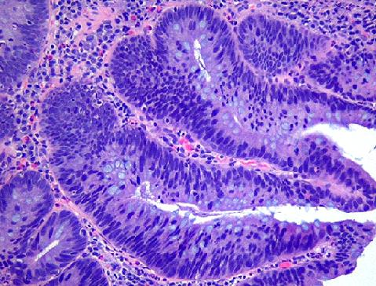
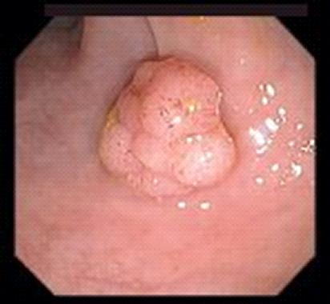
Tubulovillous Adenoma
www.GI-Pathology.net
www.endoatlas.com/atlas_co.html
Tubulovillous adenoma with 80% tubular histology and 20% villous histology
Endoscopic image of a tubulovillous adenoma

Slide 8
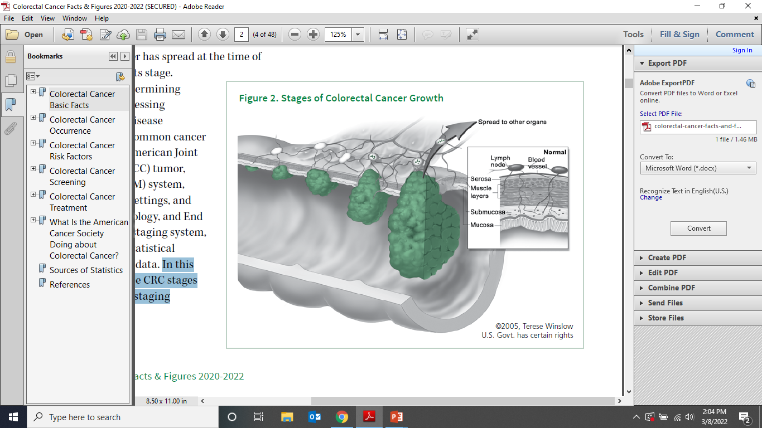
What are the stages of colorectal cancer?
SEER Staging System
Surveillance, Epidemiology, and End Results (SEER) summary staging system, used for descriptive and statistical analysis of tumor registry data. Here we will describe CRC stages using the SEER summary staging system:
In Situ
Localized
Regional
Distant

Slide 9
AJCC Staging System
Primary Tumor (T)
TX Primary tumor cannot be assessed T0 No evidence of primary tumor Tis Carcinoma in situ; intraepithelial or invasion of lamina propria T1 Tumor invades submucosa T2 Tumor invades muscularis propria T3 Tumor invades through the muscularis propria into the subserosa, or into non- peritonealized pericolic or perirectal tissues T4 Tumor directly invades other organs or structures, and/or perforates visceral peritoneum
Regional Lymph Nodes (N)
NX Regional lymph nodes cannot be assessed N0 No regional lymph node metastasis N1 Metastasis in 1 to 3 regional lymph nodes N2 Metastasis in 4 or more regional lymph nodes
Distant Metastasis (M)
MX Distant metastasis cannot be assessed M0 No distant metastasis M1 Distant metastasis
American Joint Committee on Cancer (AJCC)tumour, node, and metastasis (TNM) system, typically used in clinical settings.
Stage Grouping
Stage T N M
0 Tis N0 M0
I T1 N0 M0 T2 N0 M0
IIA T3 N0 M0
IIB T4 N0 M0
IIIA T1-T2 N1 M0
IIIB T3-T4 N1 M0 IIIC Any T N2 M0
IV Any T Any N M1

Slide 10
What are the symptoms of colorectal cancer?
Early CRC often has no symptoms, The most common symptoms are:
Bleeding from the rectum
Blood in the stool or in the toilet after having a bowel movement
Dark or black stools
A change in bowel habits or the shape of the stool
Cramping, pain, or discomfort in the lower abdomen
An urge to have a bowel movement when the bowel is empty
Constipation or diarrhea that lasts for more than a few days
Decreased appetite
Unintentional weight loss

Slide 11

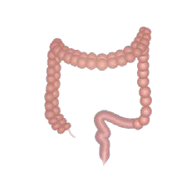

Colorectal Cancer Risk Factors
Non-modifiable Risk Factors
FAMILY HISTORY AND INHERITED DISEASES
INFLAMMATORY BOWEL DISEASE (IBD)
RACE AND ETHNICITY

Slide 12
Lynch Syndrome (HNPCC)
(Hereditary Non-Polyposis Colorectal Cancer)
HNPCC is an autosomal dominant syndrome caused by a germline mutation in one of the DNA mismatch repair
(MMR) genes. It is associated with 2% - 3% of all colon cancer cases. The lifetime risk of a developing colon cancer can be as high as 70%. In recent report, median age of colon cancer diagnosis in patients with Lynch Syndrome (HNPCC) was 54 years in men and 70 years in women. This syndrome is also associated with tumors of other organs such as the uterus, ovaries, stomach, pancreas, ureters, kidneys, small bowel, biliary tract, and brain.

Slide 13
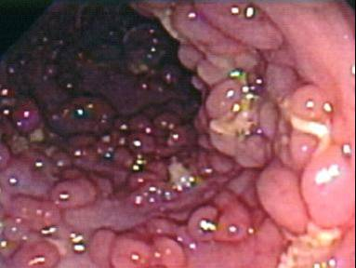
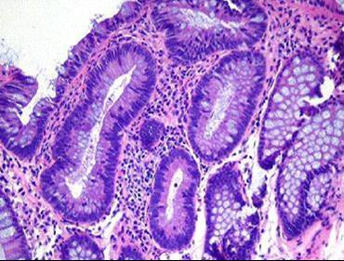
Familial Adenomatous Polyposis
FAP is an autosomal dominant syndrome caused by germline mutation in the APC gene. It accounts for < 1% of all colon cancer cases. Approximately 50% of affected patients develop adenomatous polyps by age 15 and 95% by age 35. The average age at diagnosis of colon cancer is about 35-40 years. The lifetime risk of developing colon cancer in a patient with FAP approaches 100%.
www.GI-Pathology.net
www.GI-Pathology.net

Slide 14
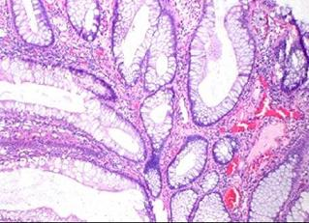
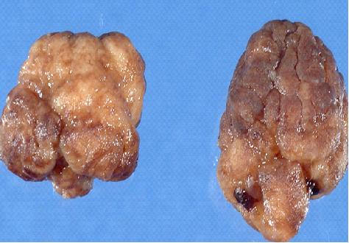
Hamartomatous Polyposis Syndromes
Peutz Jeghers
It is an autosomal dominant syndrome notable for perioral pigmentation and histologically distinct gastrointestinal polyps. The lifetime risk for colon cancer is 40% and for breast cancer >50%.

Slide 15
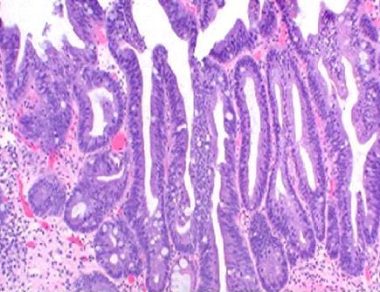
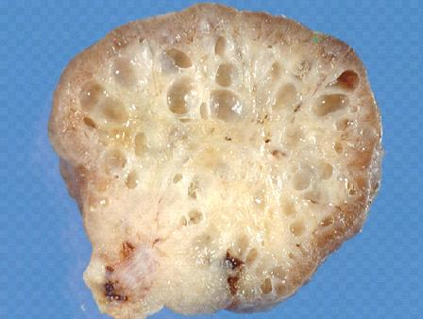
Hamartomatous Polyposis Syndromes
Juvenile Polyposis
It is an autosomal dominant syndrome. The lifetime risk for colon cancer is 60% with a mean age of presentation at age 34.

Slide 16

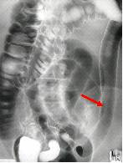
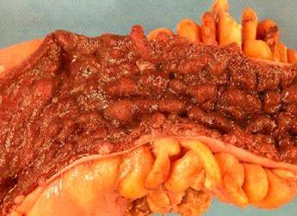
Inflammatory Bowel Disease
Ulcerative Colitis & Crohn’s Colitis
www.learningradiology.com
www.GI-Pathology.net
www.GI-Pathology.net
Ulcerative Colitis gross specimen
Crohn’s Colitis endoscopic view
Barium enema: colon with "lead-pipe" appearance in ulcerative colitis

Slide 17





Colorectal Cancer Risk Factors
Modifiable Risk Factors
EXCESS WEIGHT
SEDENTARY BEHAVIORS
SMOKING
ALCOHOL
RED MEAT AND PROCESSED MEATS

Slide 18
Recommended options for colorectal cancer screening
The typically slow course of growth from precancerous polyp to invasive cancer to advanced-stage disease provides a unique opportunity for the prevention and early detection of CRC.
Screening can prevent cancer through the detection and removal of precancerous growths and detect the disease at an early stage, when treatment is usually more successful. As a result, screening reduces CRC mortality both by decreasing incidence and increasing survival.
There are several recommended methods for CRC screening, including both visual examinations, which are performed at a health care facility, and high-sensitivity stool-based tests. All tests have a comparable ability to improve life expectancy when performed at the appropriate time intervals and with the recommended follow-up.

Slide 19
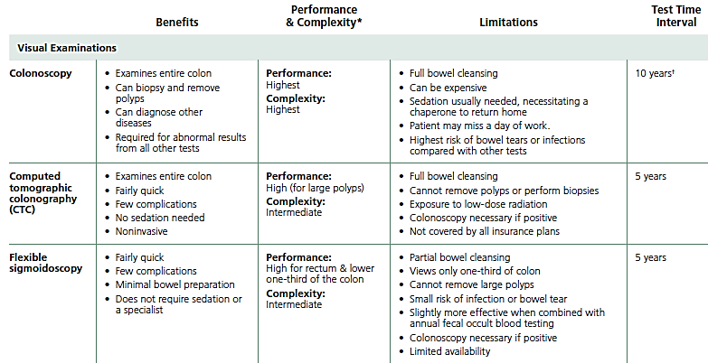
Characteristics of Recommended Colorectal Cancer Screening Tests

Slide 20
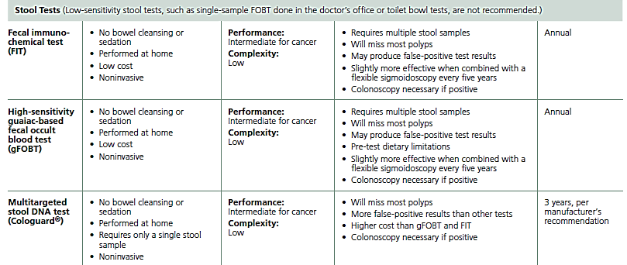
Characteristics of Recommended Colorectal Cancer Screening Tests

Slide 21
Non-recommended tests for colorectal cancer screening
There are several tests for CRC screening that are not recommended by the American Cancer Society or other organizations because of poorer performance. These include
In-office stool tests.
Toilet bowl tests.
Double-contrast barium enema.
Blood-based tests that measure genetic abnormalities associated with colorectal cancer.
Capsule endoscopy.

Slide 22
Colorectal Cancer Treatment
Treatment for CRC has advanced rapidly over the past several decades, particularly for advanced disease. However, it has also become increasingly clear that outcomes vary widely based on tumor-specific molecular features, tumor location, and patient characteristics.
Treatment decisions are made by patients with their physicians after considering the best options available for their tumor characteristics along with the risks and benefits associated with each.

Slide 23
Colon & Rectal cancer
1. Carcinoma in situ:
polypectomy or Resection of a segment of the colon.
2. Localized stage:
Surgical resection to remove the cancer, together with a length of normal colon on either side of the tumor and nearby lymph nodes, is the standard treatment.
3. Regional & Distant stage:
Surgical resection followed by chemotherapy depending on the stage.
Chemotherapy and targeted therapies may be given alone or in combination to relieve symptoms and prolong survival.

Slide 24
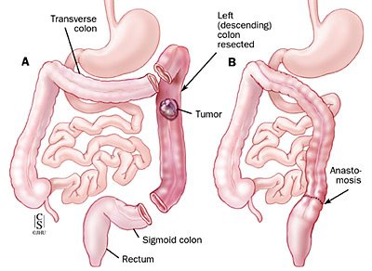
Left Hemicolectomy

Slide 25
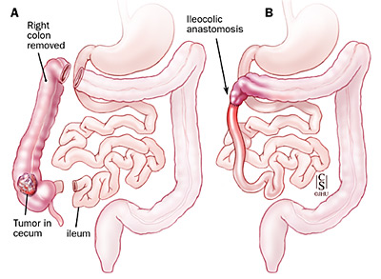
Right Hemicolectomy

Slide 26
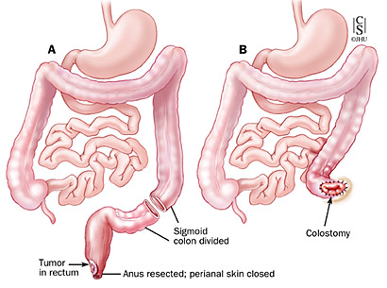
Abdominoperineal Resection

Slide 27
Colostomy
When a section of the colon or rectum is removed during surgery, the healthy parts can usually be reconnected, allowing the patient to eliminate waste normally. When reconnection is not immediately possible, the surgeon connects the colon to an opening (stoma) that is made in the skin of the abdomen, allowing waste to leave the body.
The surgical procedure to create an opening in the body for the elimination of waste is called an ostomy. When the stoma is connected to the colon it is called a colostomy; when the stoma is connected to the small intestine it is called an ileostomy.
Most patients with CRC who require a colostomy need it only temporarily, until the colon or rectum heals from surgery.
A permanent colostomy is necessary more often for rectal than for colon cancer patients.

Slide 28

THANK YOU

