Slide 1
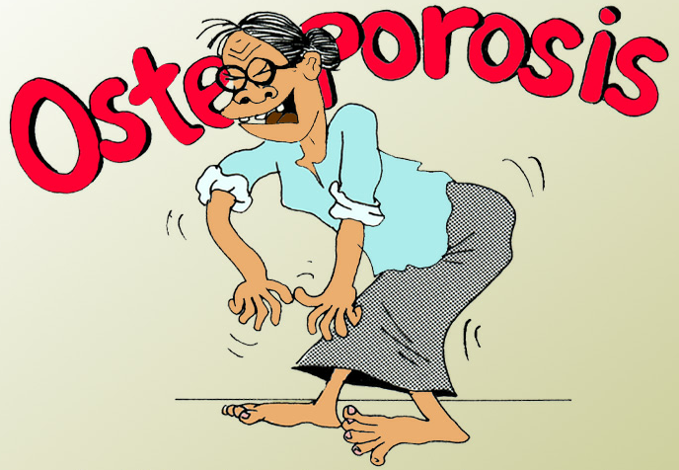

Slide 2
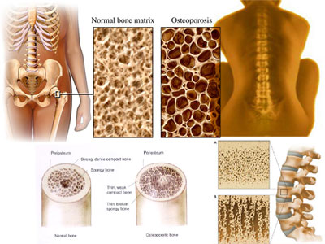
What is Osteoporosis?
“Silent disease” until complicated by fractures
The most common bone disease in humans is characterized by:
Low bone mass
Micro-architectural deterioration
Compromised bone strength
Increased risk for fracture

Slide 3
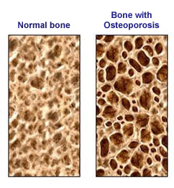
What causes osteoporosis?
Osteoporosis results from a loss of bone mass (measured as bone density) and from a change in bone structure.
Many factors will raise your risk of developing osteoporosis and breaking a bone.
Recognizing your risk factors is important so you can take steps to prevent this condition or treat it before it becomes worse.

Slide 4
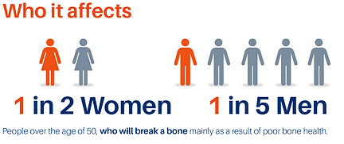

Slide 5
Common risk factors for osteoporosis
Female
Postmenopausal
Family history of osteoporosis
Lack of exercise
Small body frame
Low calcium intake
Vitamin D deficiency
Smoking
Age (starting in the mid-30s but more likely with advancing age)
Rheumatoid arthritis, hyperthyroidism, hyperparathyroidism, hypogonadism
Medications – corticosteroids, excess thyroid hormone, Diuretics, and anticonvulsants

Slide 6
Factors Associated with Bone Loss in Men
Genetics
Smoking/alcohol
Calcium intake
Physical activity/strength
Testosterone production
Estrogen production

Slide 7
Risk Assessment / Diagnosis
After menopause, all women should be evaluated clinically for osteoporosis risk to determine need for BMD testing.
50-60% of men with osteoporosis have disorders known to reduce bone loss, such as hyperparathyroidism, intestinal disorders, malignancies, conditions resulting in immobilization.
BMD recommended in men with known risk factors and who have lost > 1.5 inches in height.
Diagnosis can be established in patients who have never had a fragility fracture by BMD measurement.

Slide 8

Do you have osteoporosis?
Osteoporosis only causes symptoms when it is far advanced.
Symptoms include loss of height, deformed spine “dowager’s hump”), unexplained back pain, and fractures.
It is best to detect problems at an early stage, when treatment is most effective.
The best test for detecting osteoporosis is bone densitometry, done with a technique called “Dual-energy X-ray Absorptiometry” or DXA.

Slide 9
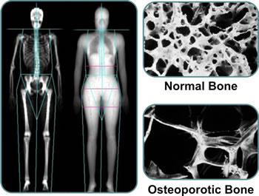
What is Bone Density Testing?
This is a way of measuring the amount of calcium in a certain amount of bone.
A standard X-ray is not a good way to measure bone density, because you must lose about 30% of your bone mass.
The most advanced is called“Dual-energy X-ray Absorptiometry” or DXA.
Often the measurements are at your spine and your hip, including femoral neck.
It is similar to an X-ray, but uses much less radiation, quick and painless

Slide 10
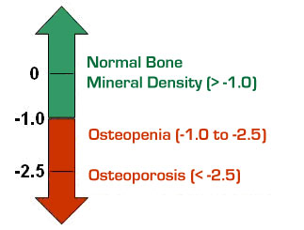
Dual-energy X-ray Absorptiometry [DXA]
DXA test results are scored compared with the BMD of young, healthy people.
The risk of fracture most often is lower in people with osteopenia than those with osteoporosis. But, if bone loss continues, the risk of fracture increases.
This results in a measure called a T-score.
DXA T-score | Bone mineral density (BMD)
Not lower than –1.0 | Normal
Between –1.0 and –2.5 | Osteopenia
–2.5 or lower | Osteoporosis

Slide 11
The categories for which bone densitometry is most often done are:
Estrogen deficient women undecided about taking hormones.
Those with spinal abnormalities or X-ray evidence of bone loss.
Anyone taking long-term corticosteroid treatment (such as Prednisone).
Primary hyperparathyroidism with no symptoms.
Monitoring of therapy for osteoporosis.

Slide 12
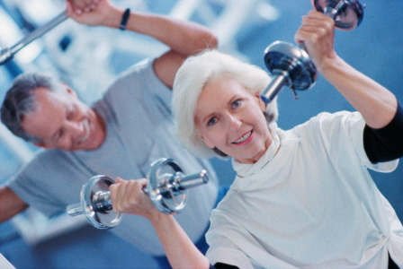
How is osteoporosis treated?
FDA-Approved Drugs for Osteoporosis
Bisphosphonates
Selective Estrogen Receptor Modulators (SERMs)
Calcitonin
Parathyroid Hormone
Estrogen/Hormone Therapy (ET/HT)
Besides the approved drugs, maintaining the followings are required
Calcium
Vitamin D
Physical activity

Slide 13
Prevention
Lifestyle changes may be the best way of preventing osteoporosis.
Make sure you get enough calcium in your diet or through supplements (roughly 1,000–1,200 mg/day, but will depend on your age).
Get enough vitamin D (400–1,000 IU/day, depending on your age and your blood level of vitamin D measured by your doctor).
You also should get treatment of any underlying medical problem that can cause osteoporosis.
Stop smoking.
Engage in weight-bearing exercise. Aim for at least 30 minutes a day five times a week or 50 minutes a day three times a week.

Slide 14
Living with osteoporosis
If you have osteoporosis, it is important to help prevent not just further bone loss but also a fracture.
Here are some ways to decrease your chance of falls:
Use a walking aid. If you are unsteady, use a cane or walker.
Remove hazards in the home. Remove throw rugs. Also, remove or secure loose wires or cables that may make you trip. Add nightlights in the hallways leading to the bathroom. Install grab bars in the bathroom and nonskid mats near sinks and the tub.
Get help carrying or lifting heavy items. If you are not careful, you could fall, or even suffer a spine fracture without falling.
Wear sturdy shoes. This is above all true in winter or when it rains.

Slide 15
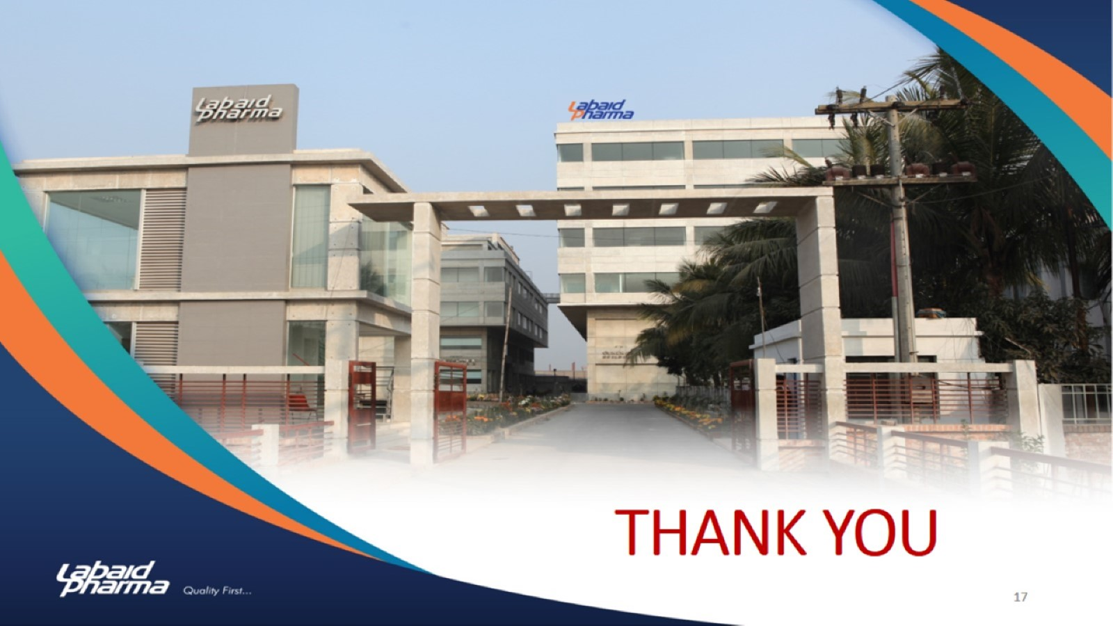
THANK YOU

