Slide 1
Tourniquet in Orthopedic Surgery

Slide 2
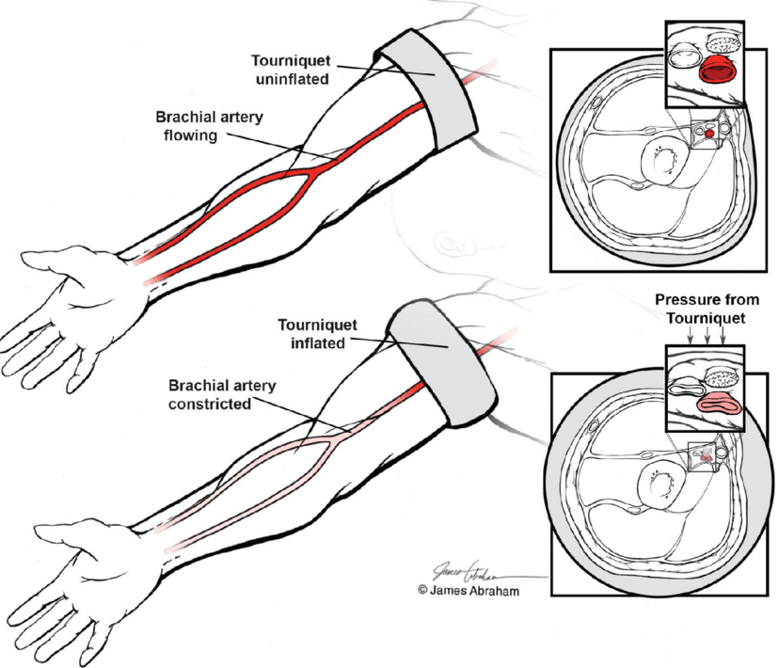
Definition
It is surgical equipment which applied over a limb to control venous or arterial circulation to make the operative field bloodless for a while.

Slide 3
Tourniquet in Surgery of the Limbs: A Review of History
The first recorded efforts to prevent arterial bleeding has been ascribed to Sushruta, the father of surgical art and science, in 600 B.C .At that time, he pressed the arteries with pieces of leather -which we now call the tourniquet . The use of the tourniquet, which prevents blood entrance and exit from the limb, has been historically close to amputation.
The tourniquet was first used in 200 BC and continued up to 500 A.C during Roman emperors’ era . At that time, saving the life of soldiers or patients with ignorance of the limb was the goal and leather instruments or bronze rings were used for this purpose.
Lister probably was the first surgeon who used a blood free field created by a tourniquet in a surgery other than for amputation.

Slide 4
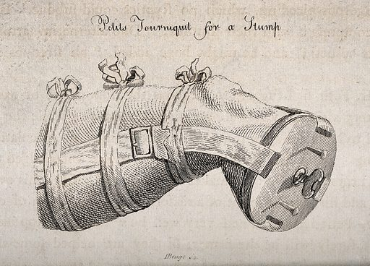
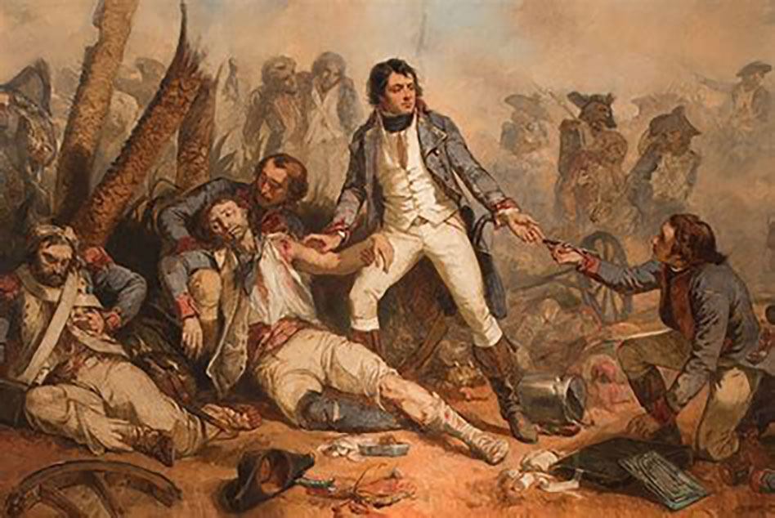
Tourniquet in Surgery of the Limbs: A Review of History

Slide 5
Tourniquet in Surgery of the Limbs: A Review of History
Galen, the most famous surgeon of Rome, advocated against the use of tourniquet because it increased bleeding and probably caused low blood pressure that suppressed the venous return

Slide 6
Tourniquet in Surgery of the Limbs: A Review of History
The next tourniquet that was commonly used was a flat rubber bandage, which was first introduced by Johann Friedrich August von Esmarch,
In 1904, Harvey Cushing developed a pneumatic tourniquet.
In 1984 Mac Evan, a biotechnology engineer from Vancouver, invented a micro-computerised tourniquet system. These newer systems can measure pressure and tourniquet time continuously to prevent sudden drops in tourniquet pressure. It can also measure the mean occlusion pressure for every patient.

Slide 7
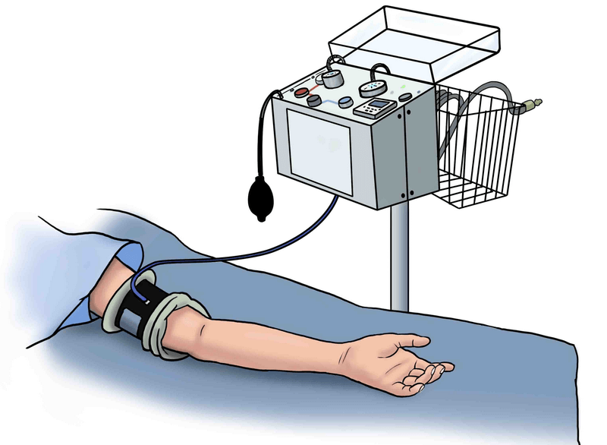
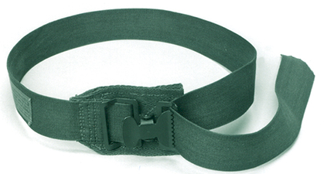
Types:
Pneumatic
Non pneumatic.

Slide 8
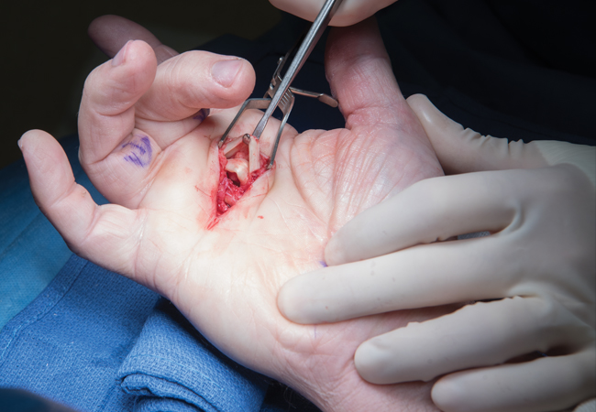
Purposes:
To improve the visibility in surgery.
To reduce blood loss.
Control bleeding in traumatic case.
Intravenous regional anaesthesia( Bier’s Block)

Slide 9
Principles of Tourniquet use
Exsanguinate the limb prior inflating tourniquet,
The tourniquet cuff should be as wide as the diameter of the limb,
Apply as proximally as possible,
Apply padding to the site, without creases.
When the tourniquet is inflated, time must be noted.
When the tourniquet is removed – the site should be inspected for any damage and the return of circulation.
This information should be recorded in notes.

Slide 10
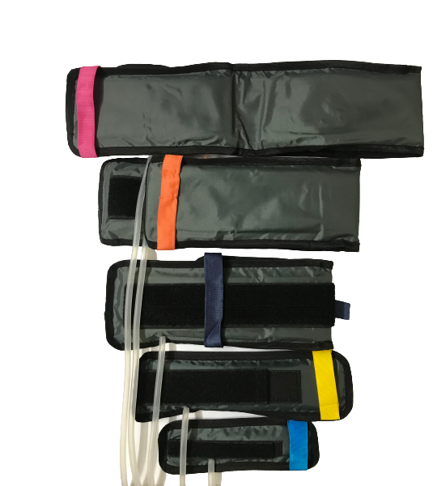
TOURNIQUET CUFF
Only a pneumatic cuff should be used and it should be at least as wide as the diameter of the limb.
Wide cuffs reduce the pressure needed for vascular occlusion.
A layer of wool bandage beneath the pneumatic tourniquet will distribute the pressure and prevent wrinkling of the underlying skin.
During skin preparation, it is essential that the sterilizing fluid does not leak beneath the cuff as this can cause a chemical burn

Slide 11
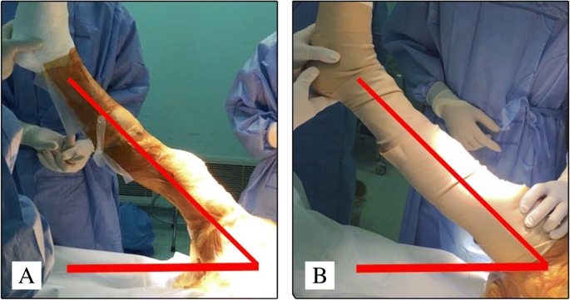
EXSANGUINATION
Elevation of the lower limb at 60 degree for 30 seconds will reduce the blood volume by 45 per cent; increasing the elevation time does not alter the percentage significantly.

Slide 12
EXSANGUINATION
The ‘squeeze’ method, in which pressure on the palm or foot is followed by sequential squeezing of the limb in a proximal direction, is also effective.
If a clearer field is required, exsanguination can be achieved by pressure using a rubber tubular exsanguinator prior to skin preparation, or if tourniquet time is to be kept to a minimum, a sterile Esmarch or gauze bandage wrapped from distal to proximal.
These methods reduce blood volume by an additional 20%.

Slide 13
TOURNIQUET PRESSURE
A tourniquet pressure of 150 mmHg above systolic is recommended for the lower limb
80–100 mmHg above systolic for the upper limb.
This may need to be increased in hypertensive, obese or very muscular patients.
Higher pressures are unnecessary and will increase the risk of damage to underlying muscles and nerves.

Slide 14
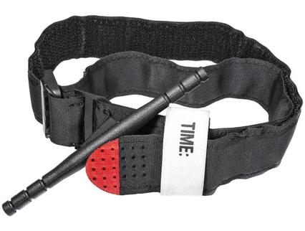
Tourniquet time
Tourniquet time is ischaemia time and thus an absolute maximum tourniquet time of 2.5 hours is allowed, although it is safer (and more advisable) to keep this under 2 hours;
transient nerve-related symptoms may occur with 3-hour tourniquet times, but full recovery is usual by the fifth day.
Time can be saved by ensuring that the limb is shaved, prepared, draped and marked before inflating the cuff.
The time of application of the tourniquet should be recorded and the surgeon should be informed of the elapsed time at regular intervals, particularly as the 2-hour period is approached.

Slide 15
Deflating and re-inflating the tourniquet
This has serious local and systemic effects. Locally deflation is followed by a hyperaemic response that reduces by half in 5, 12 and 25 minutes, respectively after ischaemic times of 1, 2 and 3 hours.
This information is useful to the surgeon trying to obtain haemostasis after tourniquet release.
There is also a variable amount of swelling, unrelated to the length of the ischaemic period; it is therefore wise not to use a tourniquet when it is not required to perform the procedure safely and for those limbs where significant swelling is already evident.

Slide 16
Deflating and re-inflating the tourniquet
At the systemic level, tourniquet deflation induces a free radical-mediated reperfusion syndrome, which adds to any muscle damage already produced by the ischaemic period.
‘Breathing periods’ (deflation followed after a pause by re-inflation), which were once popular to enable extended tourniquet times, are no longer recommended as the reperfusion effects are cumulative even though the local limb anoxia is relieved at each tourniquet deflation.
If a prolonged tourniquet time is required and unavoidable, it is wise to warn the patient of the possibility of transient nerve-related symptoms and to obtain consent to use the absolute maximum period of 3 hours.
WALANT should be considered when suitable

Slide 17
WIDE AWAKE LOCAL ANAESTHETIC NO TOURNIQUET (WALANT)
A bloodless field can be achieved by slowly infiltrating large volumes of very dilute lidocaine and adrenaline (epinephrine).
The advantage of WALANT is that there is no paralysis from the tourniquet.
This allows the surgeon to assess the effect of a tenolysis, the tension of a tendon transfer, the rotation of a fixed finger fracture throughout range of movement, and the alignment and offset of a small joint replacement.

Slide 18
Bruner’s Ten Rules of Pneumatic Tourniquet Use
APPLICATION: Apply only to a healthy limb or with caution to an unhealthy limb
SIZE OF TOURNIQUET: Arm, 10 cm; leg, 15 cm or wider in large legs
SITE OF APPLICATION: Upper arm; mid/upper thigh ideally
PADDING: At least two layers of orthopaedic felt
SKIN PREPARATION: Occlude to prevent soaking of wool.
PRESSURE: Use 50-100 mm Hg above systolic for the arm; double systolic for the thigh; or arm 200-250 mm Hg, leg 250-350 mm Hg (large cuffs are recommended for larger limbs instead of increasing pressure)
TIME: Absolute maximum 3 h (recovers in 5-7 days) generally not to exceed 2 h
TEMPERATURE: Avoid heating (e.g., hot lights), cool if feasible, and keep tissues moist
DOCUMENTATION: Duration and pressure
CALIBRATION AND MAINTENANCE: at least weekly calibration and against mercury manometer or test maintenance gauge; maintenance every 3 months

Slide 19
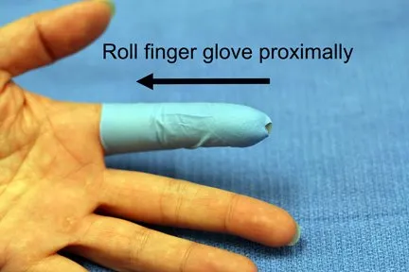
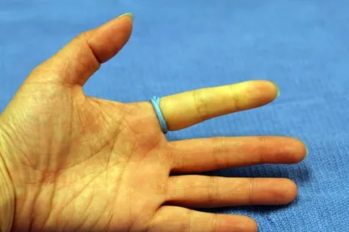
Finger tourniquet
This is suitable for relatively minor hand operations.
A sterile rubber glove-finger makes a good cuff; the tip is cut and the margin is then rolled back proximally.
Always check that the finger tourniquet has been removed at the end of the operation.

Slide 20
Contraindication
Peripheral Vascular Disease
Peripheral Neuropathy
DVT
Arterial-venous fistula

Slide 21
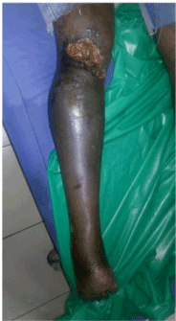
Complications
Tourniquet pain
Failed tourniquet
Nerve injury (more often due to compression than duration of ischaemia)
skin burns from leakage of alcoholic antiseptic solutions beneath the tourniquet cuff
Ischaemia & Gangrene
Reperfusion Injury

Slide 22
Take Home message
A pneumatic tourniquet with hand pump & accurate pressure gauge is safe option
An absolute maximum tourniquet time of 3 hours is allowed, although it is safer (and more advisable) to keep this under 2 hours
Always check proper disposal of tourniquet after surgery

Slide 24

THANK YOU

